Slide 1
LOCAL 871 UNION
Sue Humanick - President of Local 871
New Britain Federation of Teacher (NBFT) Membership
As an employee of a public school district, you are not alone.
You have the right to belong to your local education association/Union (known as your “local”). Our
local is NBFT Local 871.
Connecticut law has granted the association the right to:
Represent you and other district employees as your bargaining agent in negotiating the employer/employee Collective Bargaining Agreement (the contract) with the school district.
Act on your behalf in the event that the contract is violated.
Your local association is an affiliate of larger state and national associations, thereby expanding its capacity to provide services to you. NBFT’s state and national association is the American Federation of Teachers (AFT).
You can find more information on our contract with the CSDNB and NBFT/AFT benefits on NBFT.net

Slide 2
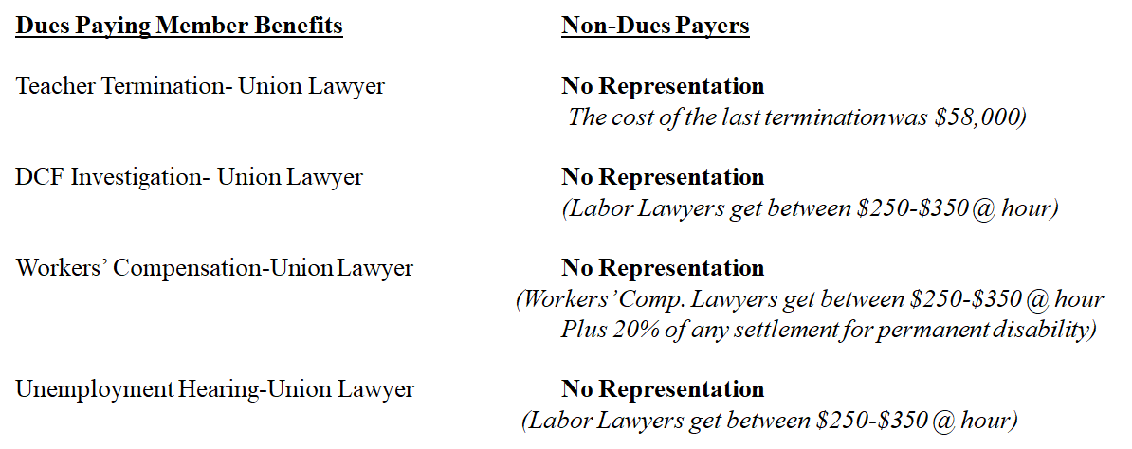
LOCAL 871 UNION
Sue Humanick - President of Local 871
NBFT Membership

Slide 3
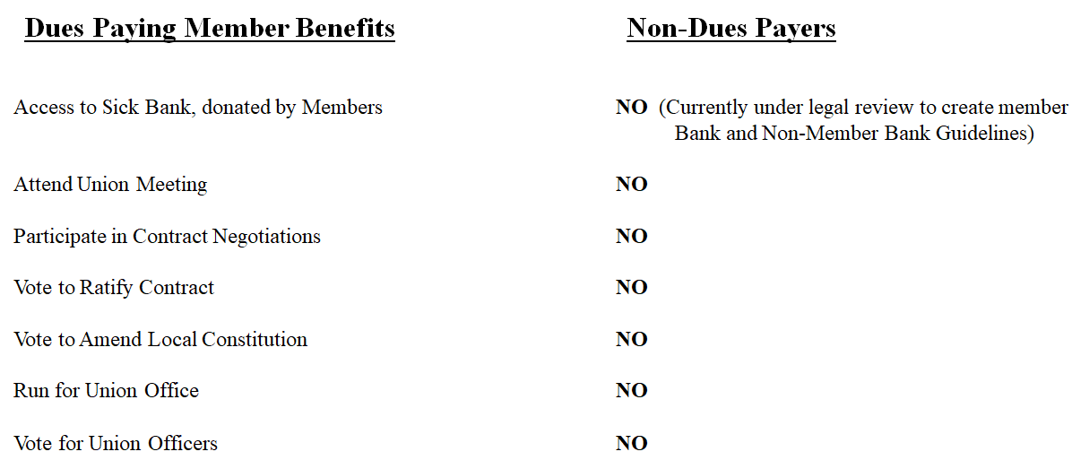
LOCAL 871 UNION
Sue Humanick - President of Local 871
NBFT Membership Dues

Slide 4
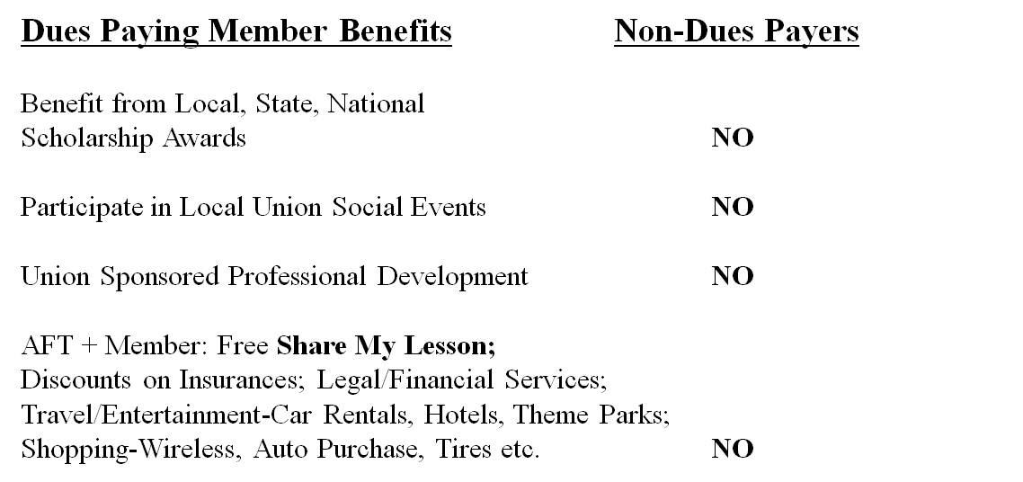
LOCAL 871 UNION
Sue Humanick - President of Local 871
NBFT Membership

